Slide 1
Community Development Block Grant (CDBG) 2025 Application for Funding
Application Workshop
May 6, 2025

Slide 2
Welcome and Introductions
Franklin County- Economic Development and Planning Staff Introductions
Ruchelle L. Pride, Interim Director
Walter Dillard, Assistant Director
Tanisha Drummond, Grants Coordinator
Julia Jones, Community Development Official
Mullin & Lonergan Associates- Consultant Staff
Bill Wasielewski- President and SME- Mullin & Lonergan
Donna King- Senior Project Manager
Kevin Tang, Housing & Community Development Specialist

Slide 3
CDBG grant funds available
The County is in the process of developing a Five-Year Consolidated Plan to establish goals and objectives to meet the priority needs in the community.
These grants fund projects to meet the priority housing, homelessness, and community development needs in Franklin County, (outside the City of Columbus).
Projects undertaken using these funds benefit persons that are low- or moderate-income or persons at risk of or experiencing homelessness.
CDBG Application Workshop ‖ Mullin & Lonergan Associates, Inc. ‖ May 2025

Slide 4
CP & AAP Process
Stakeholder Consultation & Public Participation
Housing Market Analysis
Local government, public and private agencies, housing authority, etc.
Utilize quantifiable data, stakeholder input, and citizen participation to develop this section
Housing and Homeless Needs Assessment
Strategic Plan
Priorities for 2025-2029
Utilize quantifiable data, stakeholder input, and citizen participation to develop this section
Annual Action Plan
Proposed activities for 2025

Slide 5
Basic CDBG Eligible Activities
Housing Rehabilitation
Homeownership Assistance
Public Facilities and Improvements
Blight Removal Demolition/Site Preparation
Code Enforcement
Economic Development
Acquisition / Disposition of Real Property
Public Services

Slide 6
CDBG Public Services
HUD Limits the amount that can be allocated annual to Public Services as no more than 15% of CDBG Grant Allocation
Employment Training
Crime Prevention
Childcare
Health Care
Drug Abuse Education
Fair Housing Counseling
Energy Conservation
Homebuyer Education
Recreation Programs
CDBG Application Workshop ‖ Mullin & Lonergan Associates, Inc. ‖ May 2025

Slide 7
Ineligible Activities Some Examples Include:
NO Political activities
NO Construction of housing units by a unit of local government
NO Operation and maintenance of public facilities/improvements
NO General government expenses including construction of general government buildings (except ADA improvements)
NO Purchase of equipment
NO Direct income payments

Slide 8
Meeting National Objectives
Each activity must meet one of the
THREE NATIONAL OBJECTIVES:
Benefit Low- and Moderate-Income Persons
(at least 70% of grant amount)
Prevent or Eliminate Blight
(not more than 30% of grant amount)
Urgent Needs
when health and welfare are threatened

Slide 9
Meeting a Low- and Moderate-Income Benefit
Low-mod income benefit can be qualified in three ways:
Area benefit: Census- American Community Survey (ACS) data for service area of a public improvement or facility. HUD LMISD Data map: HUD LMISD Mapping Tool- 2016-2020 ACS
Income intake: Programs that serve primarily low-and moderate-income individuals and families will be eligible for funding. The definition of a moderate-income family is no more than 80% of the area median income, adjusted for household size.
Presumed benefit: HUD presumes the following groups to be low-moderate income: abused children, battered spouses, elderly persons, disabled persons, homeless persons, illiterate adults, migrant farm workers, and persons living with AIDS.
Household Size | Low-Income (At or Below 80% AMI)
1 | $57,900
2 | $66,150
3 | $74,400
4 | $82,650
5 | $89,300
6 | $95,900
7 | $102,500
8 | $109,100

Slide 10
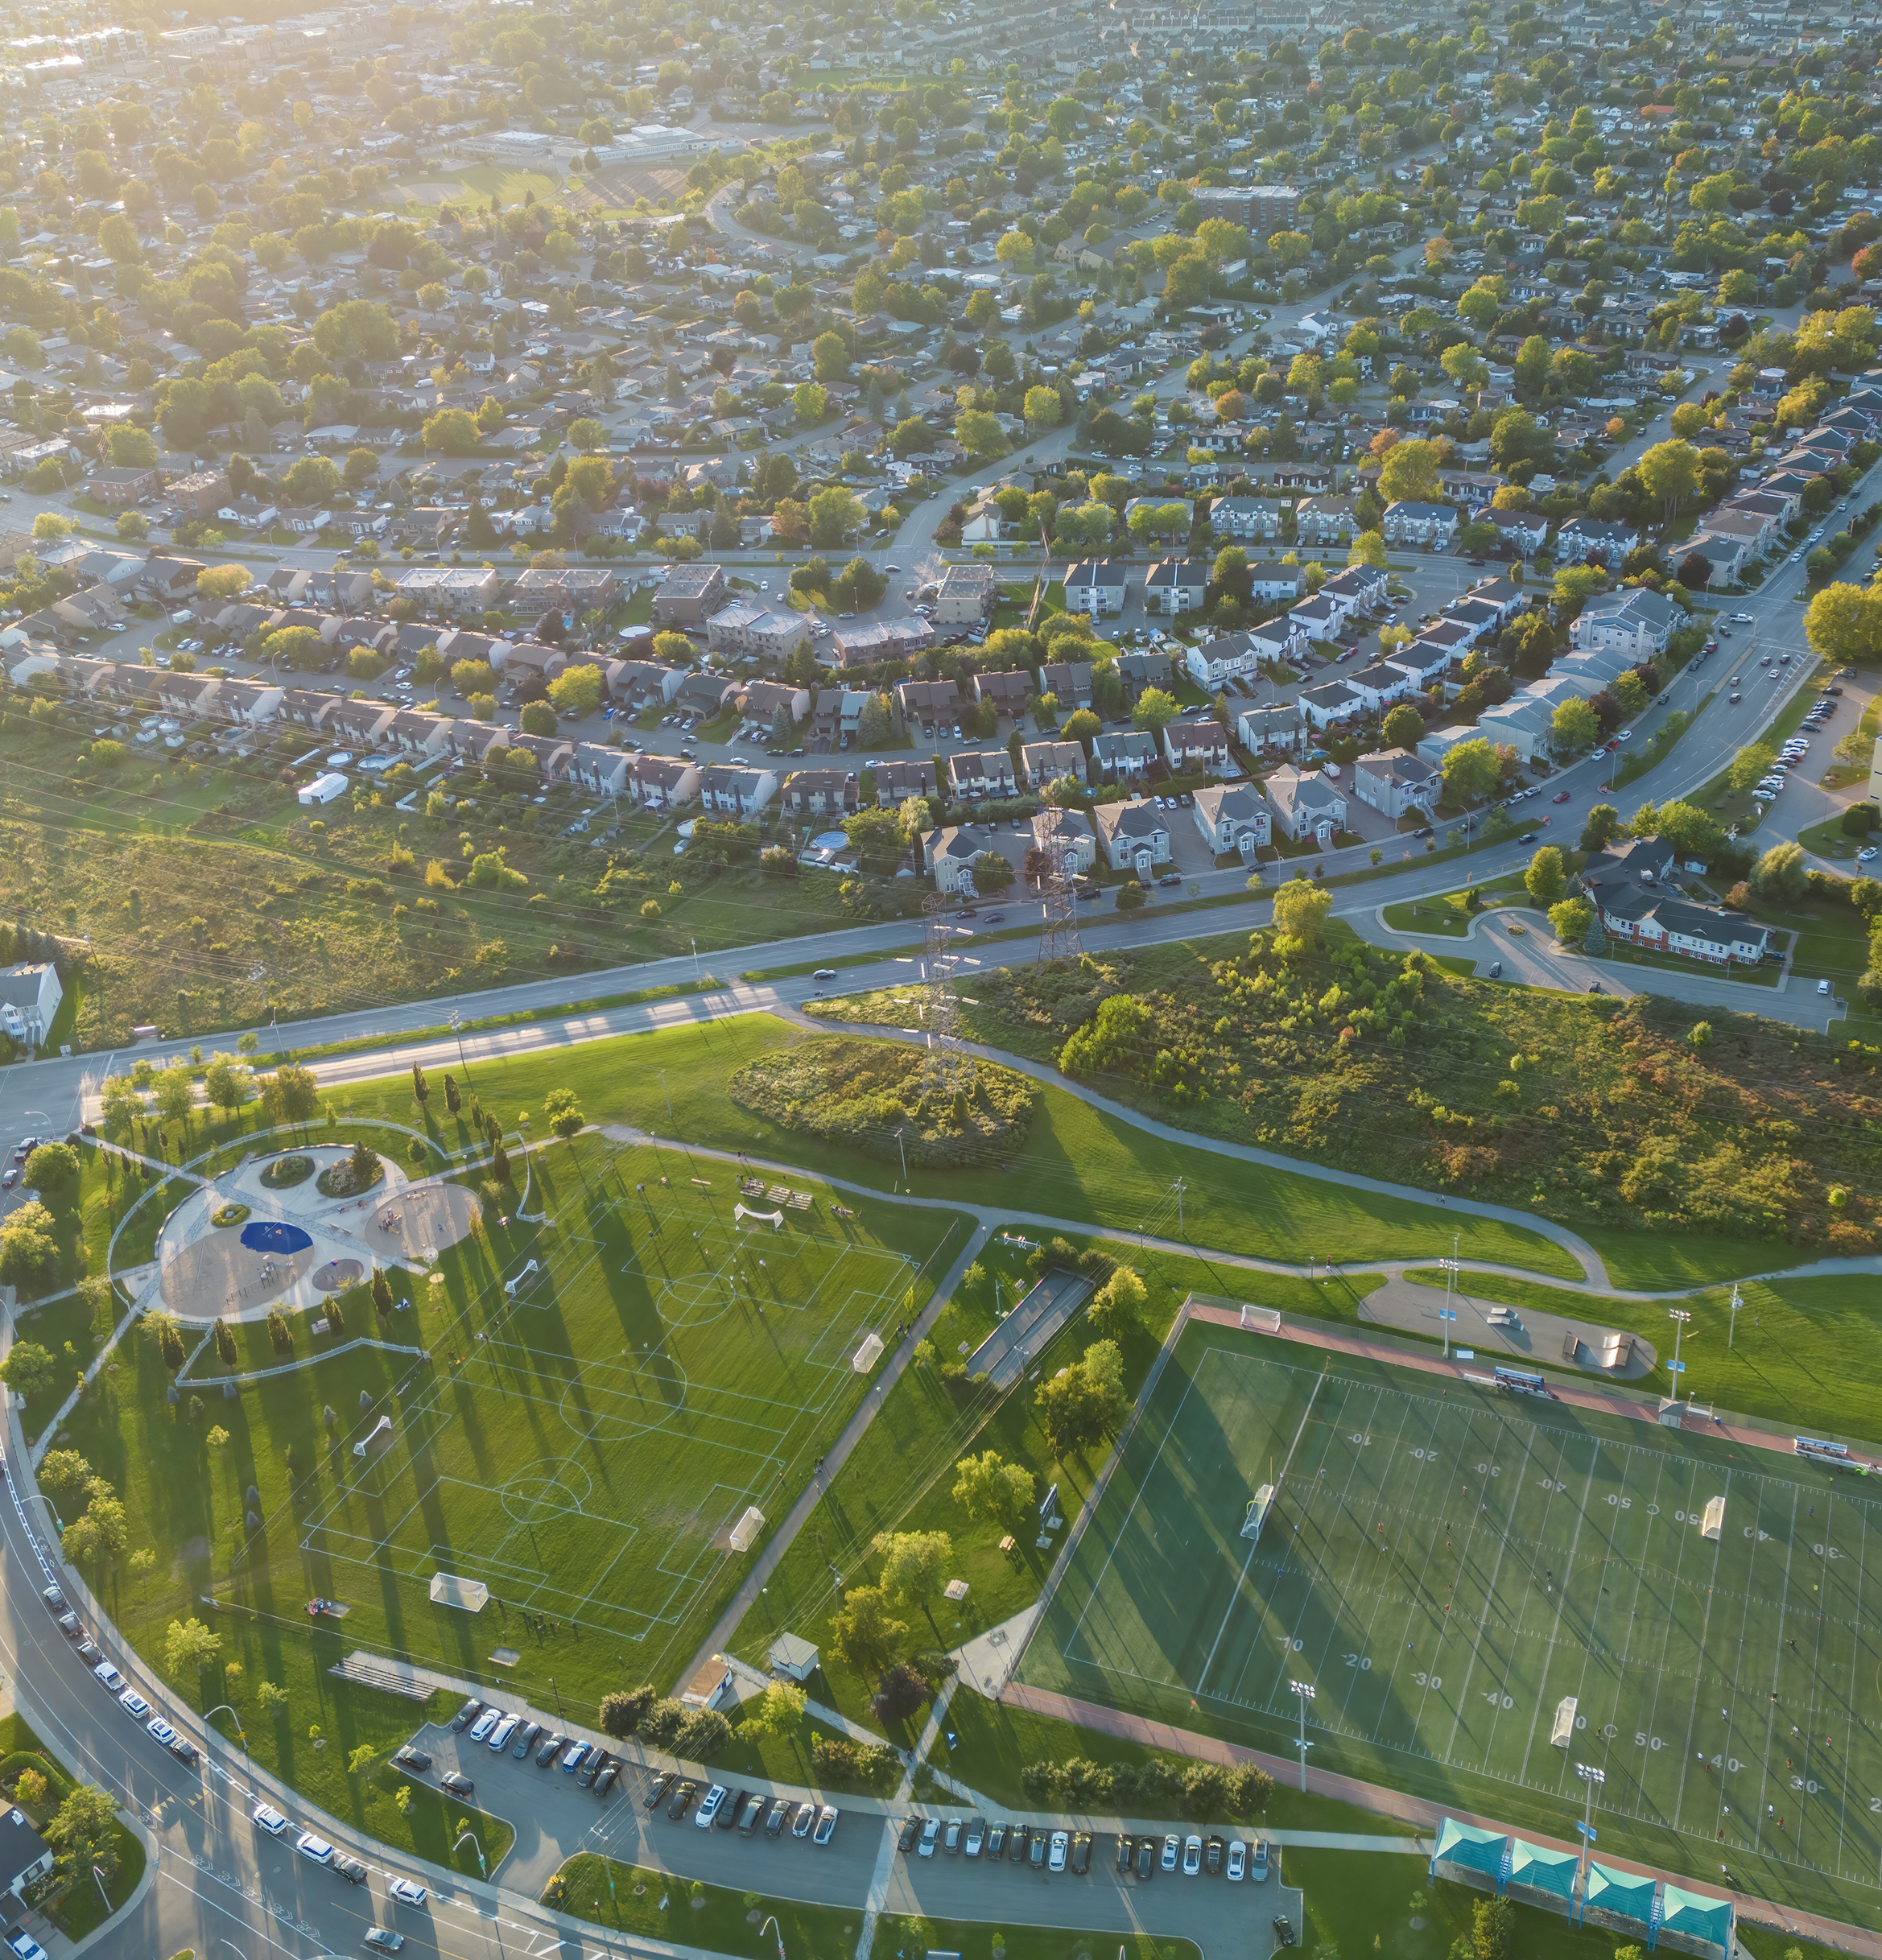
Area Benefit- Service Area
Consider who will benefit from the project.
Is the project located in an area that is primarily residential?
Does your project serve a broader area than the local neighborhood?
Does your project serve as a connector to a business district, major transportation thoroughfare?
Who is most likely to frequent your park? Will the park host large events/sporting tournaments?

Slide 11
Estimated Resources Available
Funding Source | Reprogrammed funds from 2023/2024 | Estimated 2025 Allocation | Estimated Total Available
CDBG | $2,312,671 | $2,041,576 | $4,354,243
CDBG Admin (20% of Allocation) | N/A | $408,315 | $408,315
Public Services (15% Maximum) | $346,901 | $306,236 | $653,137
Total Remaining- Other Activities | $1,965,771 | $1,327,025 | $3,292,796

Slide 12
FAQ
Projects selected for funding will be notified and additional subrecipient training provided before implementation of activities will begin, including:
Periodic reporting on activities to the County,
Process for reimbursement of eligible expenses,
Required certified payrolls for applicable projects,
How are reimbursements received, (no direct deposit available)
Insurance and fidelity bonding requirements for the subrecipient and any contractors hired to complete work on the project, and
Bid letter pre-approval process.

Slide 13
Questions?

Slide 14
Projects that Include Construction
Federal requirements, including Davis-Bacon Act and other labor standards, Section 3 (if applicable), and MBE/WBE participation apply and will be tracked and reported to Franklin County, and subsequently reported to HUD.
Awarded projects will include execution of a subrecipient agreement between the County and awarded agency, including conditions to:
Follow administrative and procurement requirements under 2 CFR Part 200- Uniform Administrative Requirements.
Reporting requirements for MBE/WBE participation and Section 3 (if applicable).
Progress Inspections and employee interviews for labor standards compliance
Weekly certified payroll reporting (certified payrolls are reviewed for accuracy before reimbursement requests are paid).
The contractor must submit certified payroll weekly and the US DOL WH347 form is available for this purpose. https://www.dol.gov/sites/dolgov/files/WHD/legacy/files/wh347.pdf

Slide 15
Application Details
Applicant active UEI from www.sam.gov (do this early as it may take 1-2 weeks to complete).
Include Project Location- if site specific and a construction activity, map must be included in application.
Include photo(s) of the project site and surrounding buildings.
For any Area Benefit- Include a map that outlines the service area so LMI percentage can be determined.
Cost estimates for construction project must be recent (within past 4 months).
Budget must include a description of the expenses that will be paid for with grant funds (if awarded)
Application must be approved and signed by the governing body (signature authority).
Matching funds are not required. Any additional project costs not covered by the grant are “leveraged” funds and should be explained in the application, including:
Are these funds secured?
If funding is awarded at a level below what is requested, can the project still move forward?

Slide 16
Project Selection Criteria
Projects will be scored based upon the following:
Completeness of Application
Detailed Project Description
Eligibility of Project
National Objective Met
Reasonable Time Frame to Complete (shovel-ready)
Project can be expected to provide a community benefit
Design/Engineering procured under CDBG rules or paid for by the applicant.

Slide 17
Application Submission
June 15th 2025 at 4:00 p.m. : Deadline to apply. Applications received after this date and time will not be considered for funding.
Applications will be accepted by mail, email, or by dropping off a hard copy in person at:
Franklin County Economic Development and Planning Department
150 S. Front Street, Suite 10
Columbus, OH 43215
Email: communitydevelopment@franklincountyohio.gov

Slide 18
For More Information
Walter Dillard, Assistant Director
Franklin County Economic Development and Planning
Contact the Franklin County Economic Development and Planning Department
communitydevelopment@franklincountyohio.gov

